Slide 1
AI, Big Data, and Blockchain Usage Examples in Japan
Tomoya Yamanaka

Slide 2
Self-Introduction
Name: Tomoya Yamanaka
Nationality : Japan
Residency: Ortigas, staying in Metro Manila for 4 years
Language: Japanese & English
Work: IT Consultant(MCT:Microsoft Certified Trainer)
Hobby: Attending/Doing Free IT Seminar
Position: IT group, Wankuma Alliance Manila director
Founder of Yellow Arrow Software Center, INC
(YASC)

Slide 3
About Wankuma Alliance
Wankuma Alliance is a Japanese pioneer free IT seminar group which have already held over 250 seminars in over 10 years, all over the world, but mostly in Japan.
Home Page(Japanese):
http://wankuma.com/
Facebook(English):
https://www.facebook.com/groups/WankumaAlliancePh/

Slide 4
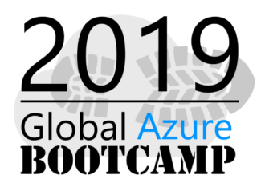
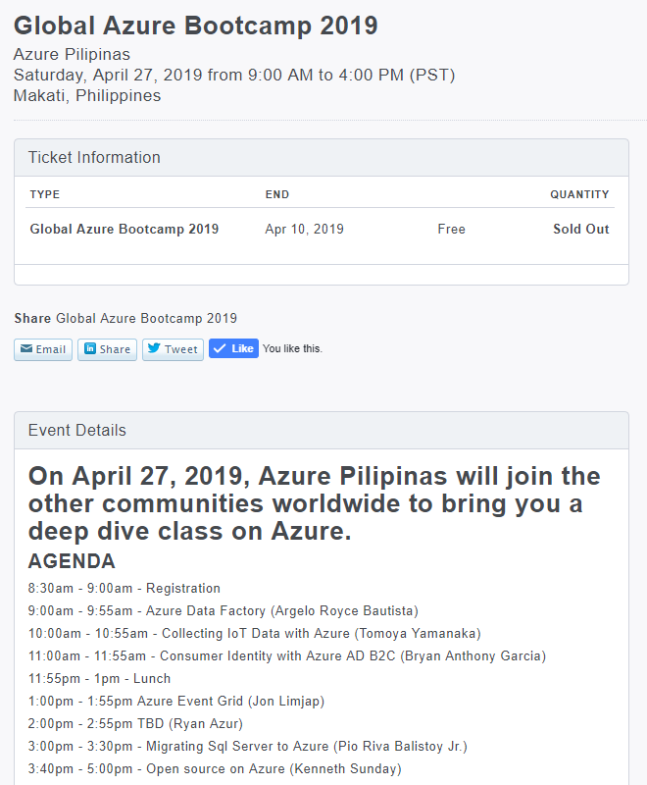
Coming Event Promotion
We will attend this event at Makati in April 27, Saturday.
https://www.eventbrite.com/e/global-azure-bootcamp-2019-tickets-57791213074

Slide 5
About Example Projects in Japan for AI, Big Data, & Blockchain
I have worked for following 2 projects in last year, using keyword technologies.
Softbank Robotics & Microsoft, IoT Data Collection System
Keyword: AI, Big Data
One Blockchain company, Face recognition logging system
Keyword: AI, Blockchain

Slide 6
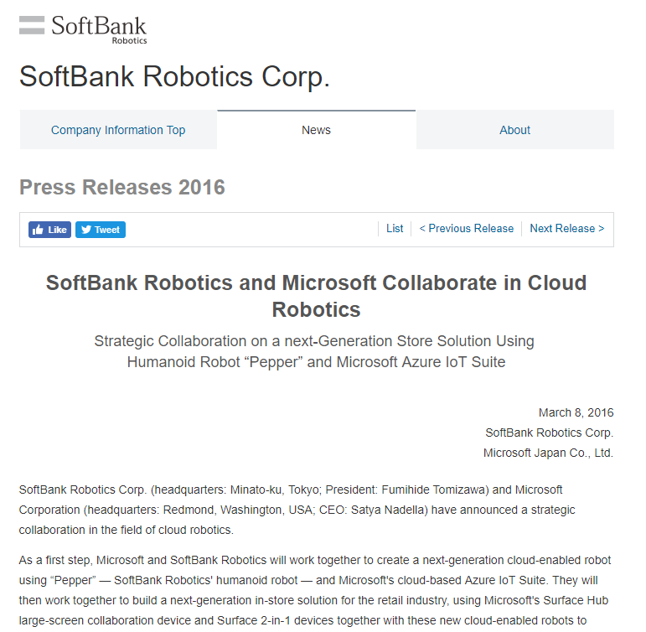
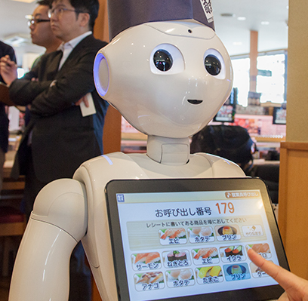
IoT Data Collection System
There was a project for collecting data from robots as Big Data creation from IoT device, robots, for AI analyzation.
https://www.softbank.jp/en/corp/group/sbr/news/press/2016/20160308_01/
https://en.wikipedia.org/wiki/Pepper_(robot)

Slide 7
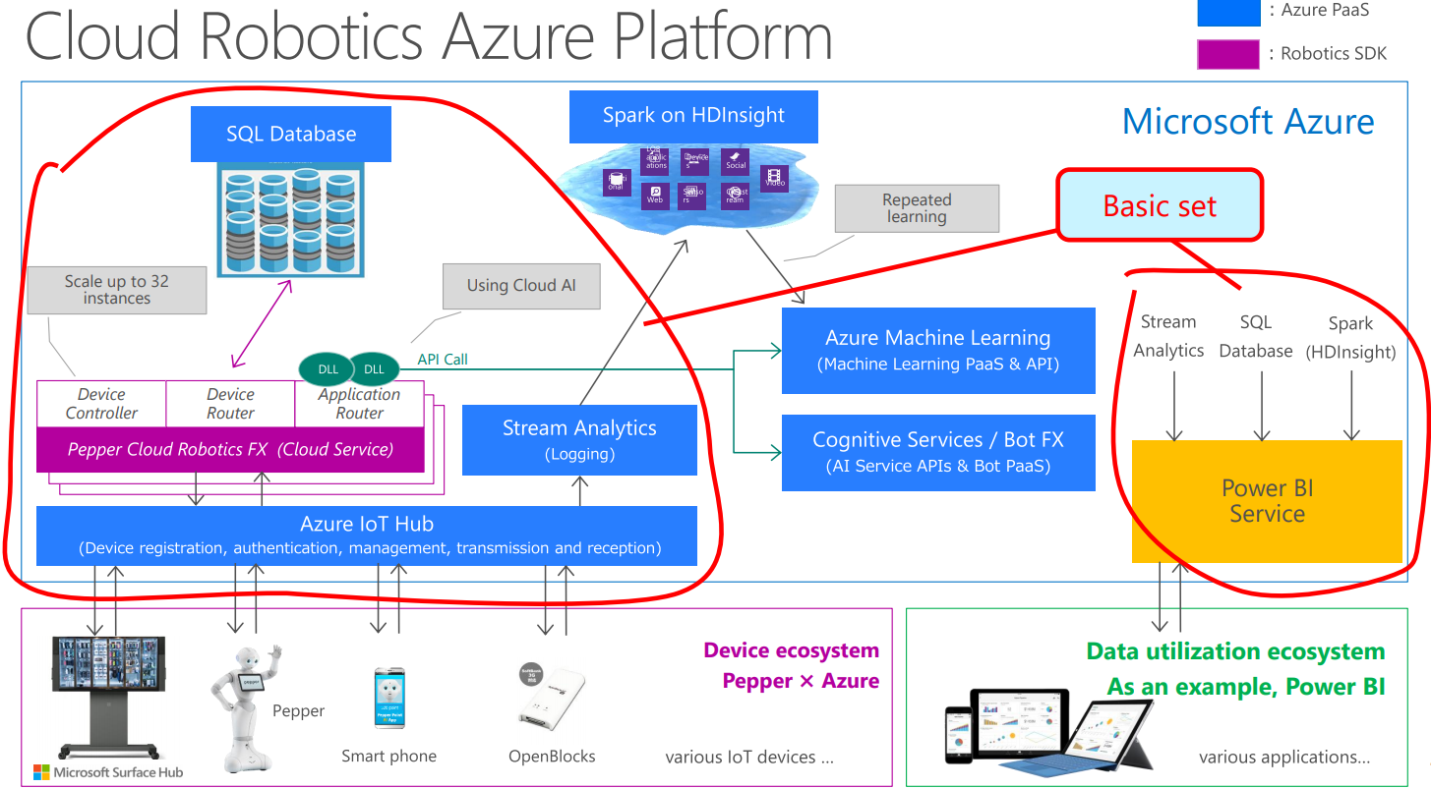
Cloud Robotics Azure Platform
The system was based on Microsoft’s open source platform, Cloud Robotics Azure Platform.
https://github.com/seijim/cloud-robotics-azure-platform-v1-sdk

Slide 8
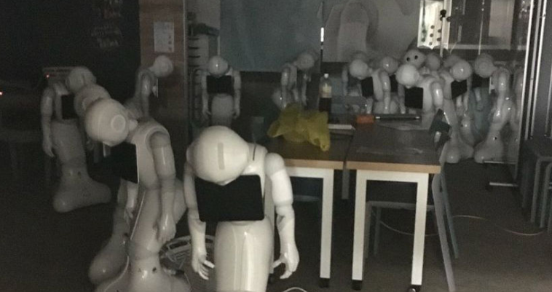
It seems not so successful as business…
There was news that most companies didn’t extend their robot lease contracts…
Even with advanced technologies, companies still need challenges

Slide 9



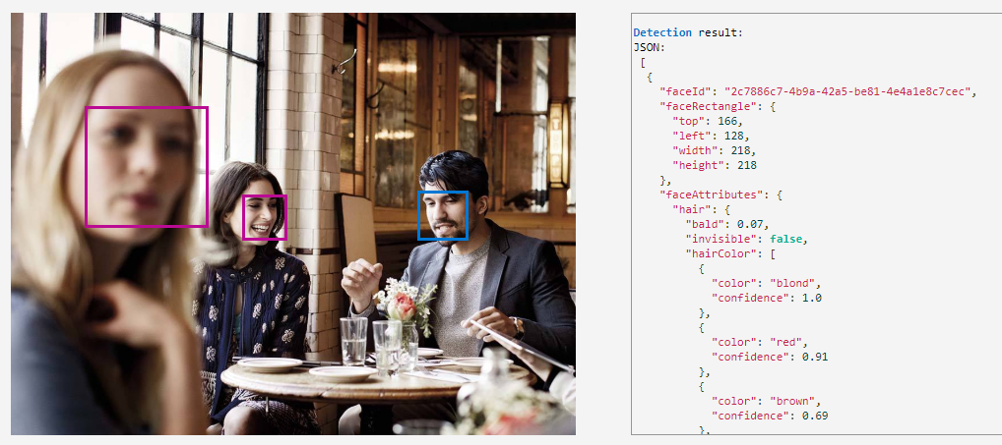
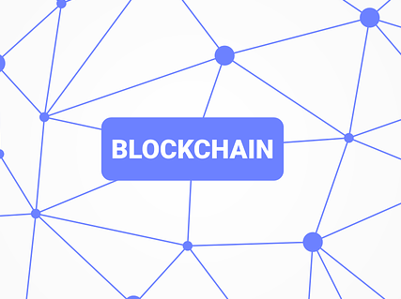
Face Recognition & Tracking System
For a client’s technology check request for easy to use and tamper-proof room enter/leave tracking system. We used one of AI technology, Face recognition, and some Blockchain technologies
Azure Face API
https://azure.microsoft.com/en-us/services/cognitive-services/face/
https://en.wikipedia.org/wiki/Blockchain

Slide 10
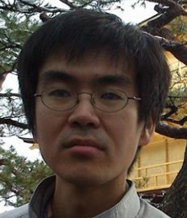



Easy to use Face Recognition Nowadays
For easy to use part request, we used one of AI technology, Face recognition from Microsoft Azure service.
Step 1.
Send pictures of person with name to let the face service to learn.
Pictures and Person’s Name
OK
Step 2.
Azure Face API
One picture
Send one picture to detect who s/he is.
He is xxx
※free instance
30,000/month free

Slide 11
Blockchain for tamper-proof
Blockchain is created to handle crypto-currency Bitcoin. Bitcoin network is, so far, never tampered and crashed by any crackers’ attacks even with its rising popularity.
Some people realized the possibility of Blockchain technology for other fields, such as item traceability, record transparency, and so on.
Because Bitcoin is too much optimized for money transactions, there are other more programable Blockchain platforms like Ethereum, NEO, etc.
We used Ethereum and NEO for room enter/leave tracking system.

Slide 12
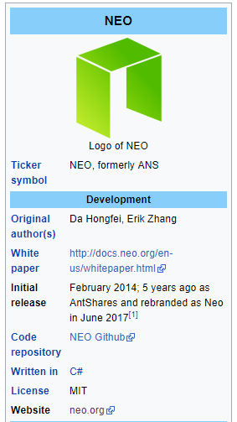
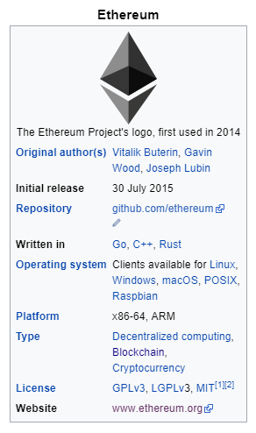
Ethereum vs NEO
Ethereum:
No.1 famous Blockchain platform!
NEO:
Good much for Microsoft programming tools.
https://en.wikipedia.org/wiki/Ethereum
https://en.wikipedia.org/wiki/NEO_(cryptocurrency)

Slide 13
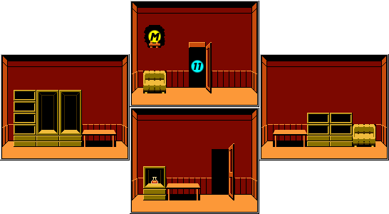

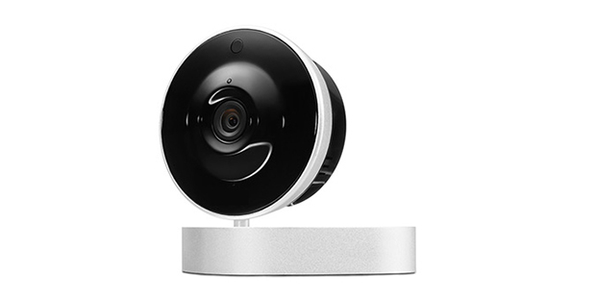
System verview
Our system overview is like following. After the system was made, it was polished and sold to one client.
Enter
Leave
Azure Face API
Step.1
Taking a picture of person who enters/leaves the room
Step.2
Sending the picture to Face service
Step.3
The result of Face service with time information is sent to Ethereum & NEO blockchains in parallel.

Slide 14
Conclusion
As I reported, the technologies are already in use in Japanese companies and I’m still getting talks for future projects.
Having new technology experiences makes good new business chances.
Let’s start to study with like today’s event!!

Slide 15
End

Slide 16
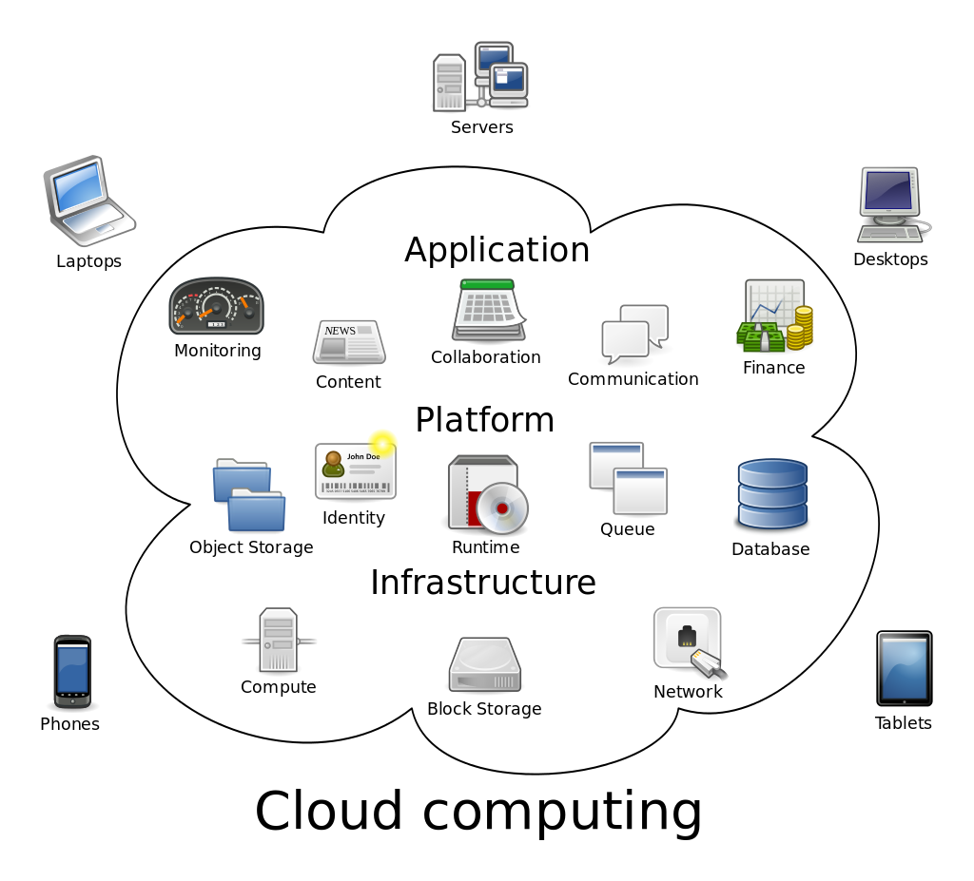
Additional Info: Japanese Company Loves Cloud
With the nice network speed and desire to disaster recovery, cloud system is so loved in Japan, even with Japanese conservative tendency. It’s almost, No Cloud, No Business!
Pros
Data can be duplicated in many safe data centers.
More flexible to start new services.
Almost unlimited resources, compared to local machines
Cons
Data can be controlled by others like GAFA
https://en.wikipedia.org/wiki/Cloud_computing

Slide 17

About Wankuma
Wan-わん- is “bowwow” by dog in Japanese.
Kuma-くま- is “bear” in Japanese.
The 2 founder of Wankuma Alliance named it with almost joking, but the activity became quite long

Slide 18
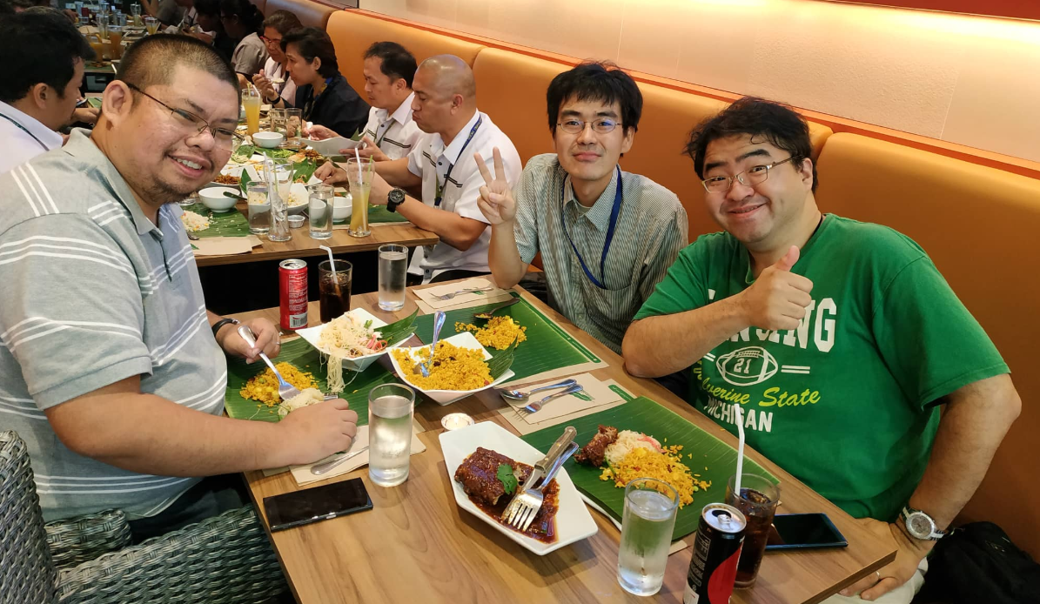
The founder of Wankuma Alliance
Founder:
Hirotoshi Naka
Big Man!

Slide 19
If you prefer Filipino group
There are many other IT groups now a days.
Following group PHINUG is my recommendation.
PHINUG(PHilippines .Net User Group) Facebook:
https://www.facebook.com/groups/phinug/
Organizer:
Jon
Limjap
Nice Guy!

Slide 20
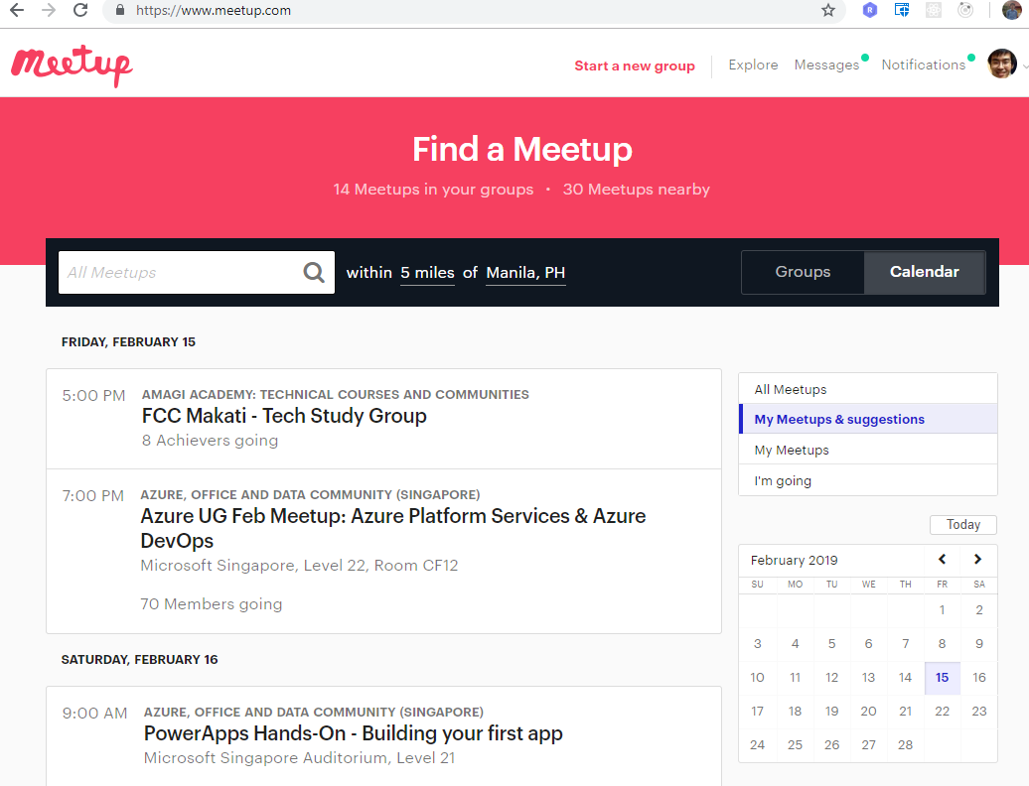
If you prefer Filipino group
You can find other groups with
https://www.meetup.com/

